Slide 1
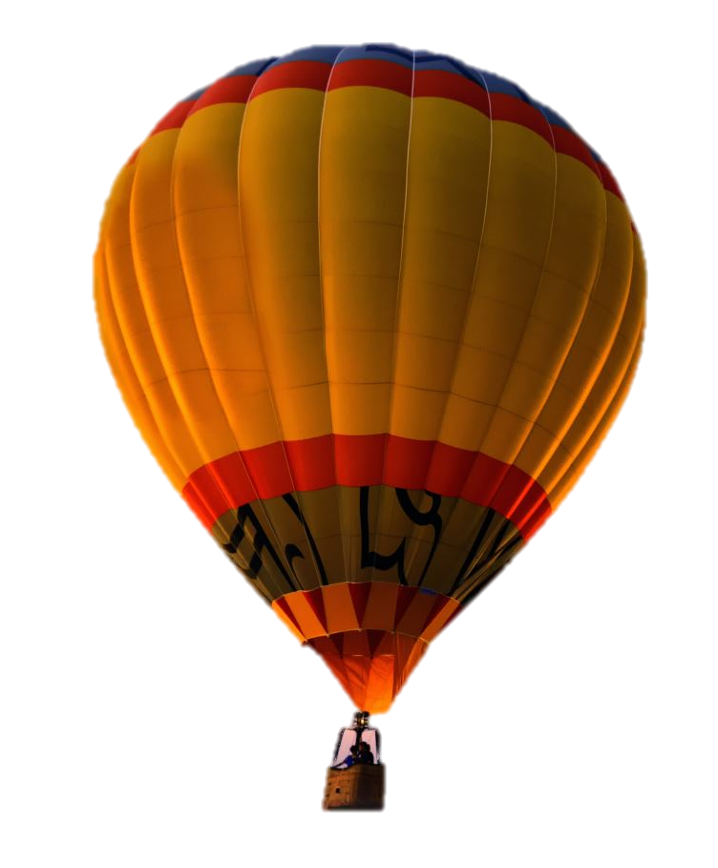

Slide 2
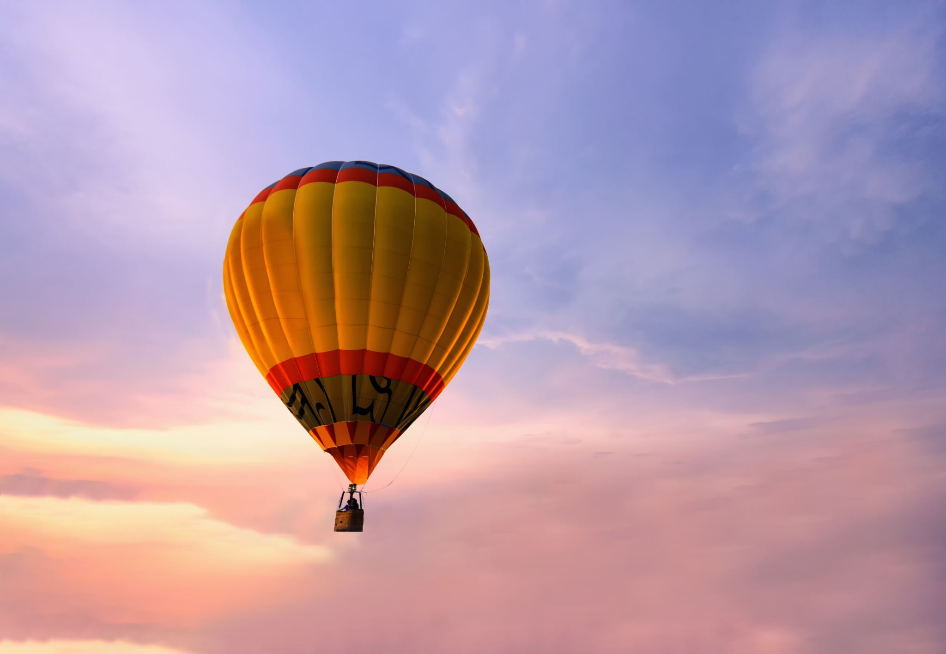
1. Click on the picture, go to PICTURE FORMAT and click on REMOVE BACKGROUND
2. Mark the areas to keep and delete so the baloon is your end result
3. BONUS – You can then click on the image, go to PICTURE FORMAT > CROP > and crop so it’s smaller

